Slide 1
Sound Tracks Clustering and Classification
Muu Nkhoma and Shuk Ying Leung

Slide 2
Data
Extracted audio features which represents the performance with basic timbal information covering the entire length of each track from a program MARSYAS
Two data set provided, one with 68 default attributes and another with 116 default plus chromatic features.
The default dataset (68) had no feature weighting or pre-filtering was applied. All features were transformed to have a mean of 0, and a standard deviation of 1.
1059 sound tracks covering 33 countries or area, except from North America.

Slide 3
Data
118 quantitative audio features of the tracks (X1, X2, X3, … X118), where X117 and X118 represent longitude, latitude.
2 additional categorical variables, region and country
The information of geographic location of origin was collected from the CD sleeve note.
No missing value

Slide 4
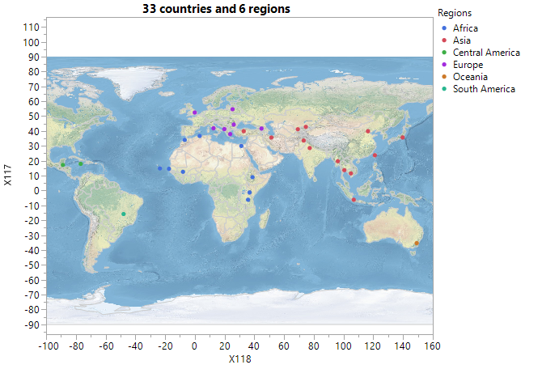

Slide 5
Table 1: The Distribution of Regions and Inclusive Counts of Countries
Region | Counts of Countries | Numbers of Observations
Africa | 9 | 305
Asia | 13 | 440
Central America | 2 | 33
Europe | 7 | 231
Oceania | 1 | 14
South America | 1 | 36
Total | 33 | 1059
5

Slide 6
Research question:
What is the performance of the clusters we form to identify the regions where all the observations were from?
How well an audio tracks can be traced to the particular region that they belong?
What variables are good at describing audio tracks according to particular regions or clusters?

Slide 7
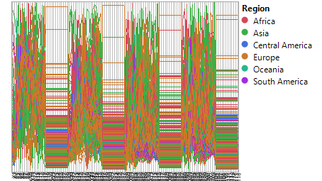
7

Slide 8
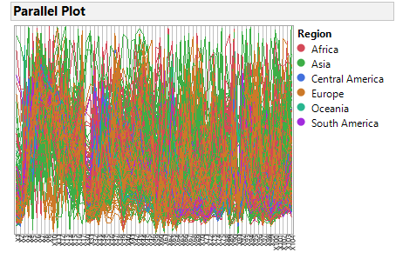

Slide 9
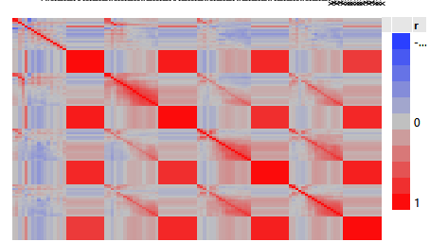

Slide 10
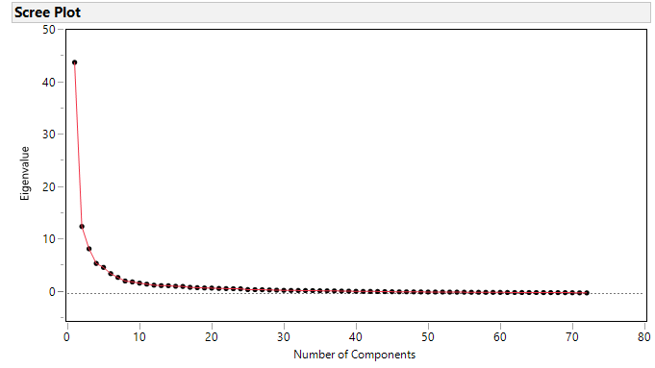
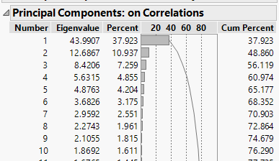
PCA
-10 pc
-Cum. % = 76.29%

Slide 11
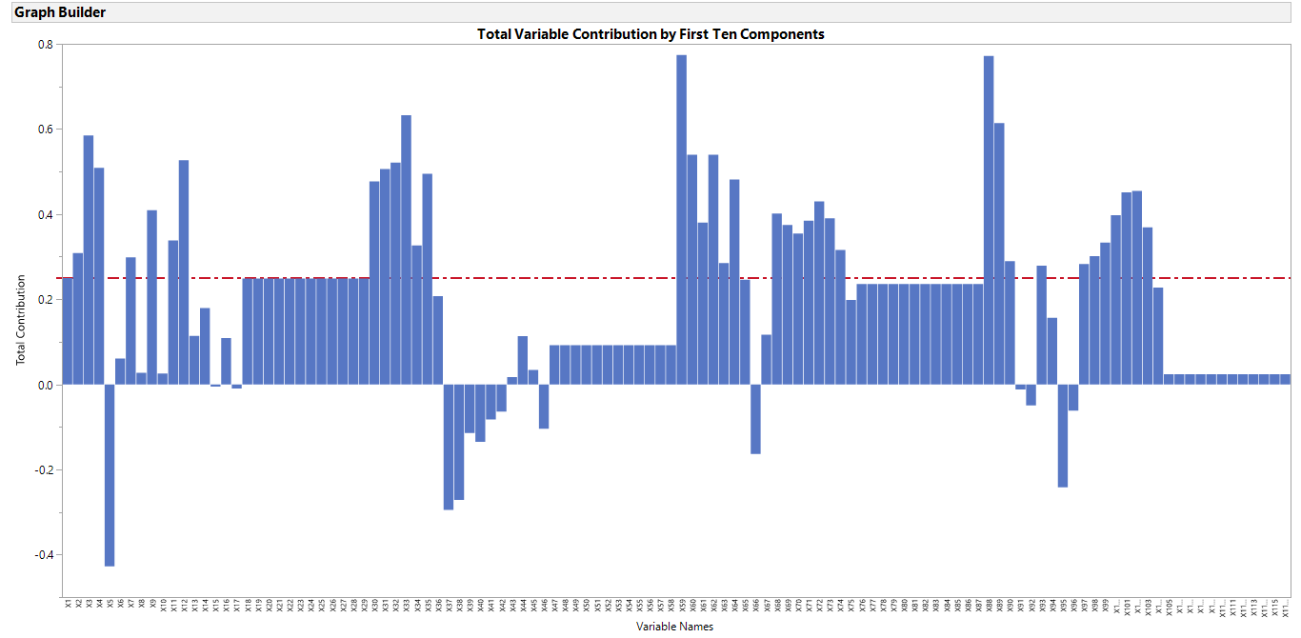
0.25 as cut off line
x18 - x29, x47 - x58, x76 –x87, x106 – x116 have the identical variability

Slide 12
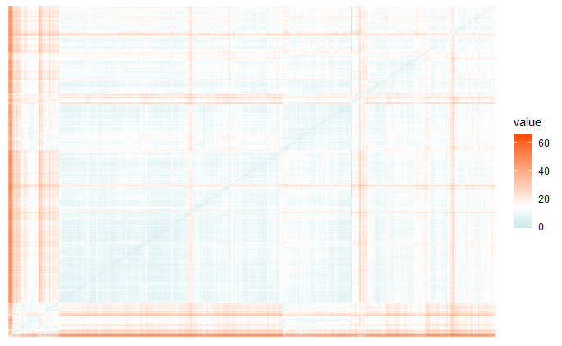
Distance Matrix
Clustering
Hierarchical Clustering methods
large number of clusters
less distinction between clusters

Slide 13
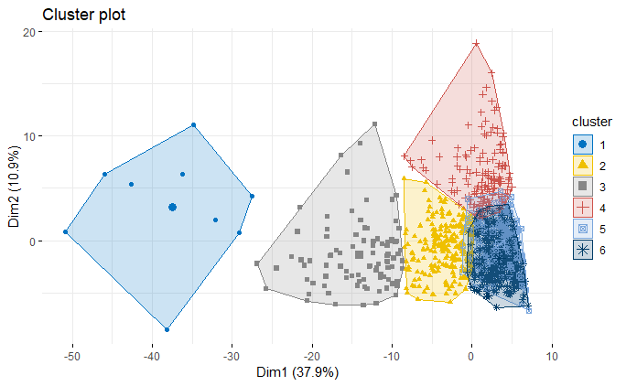
2nd Approach:
6 means clusters

Slide 14
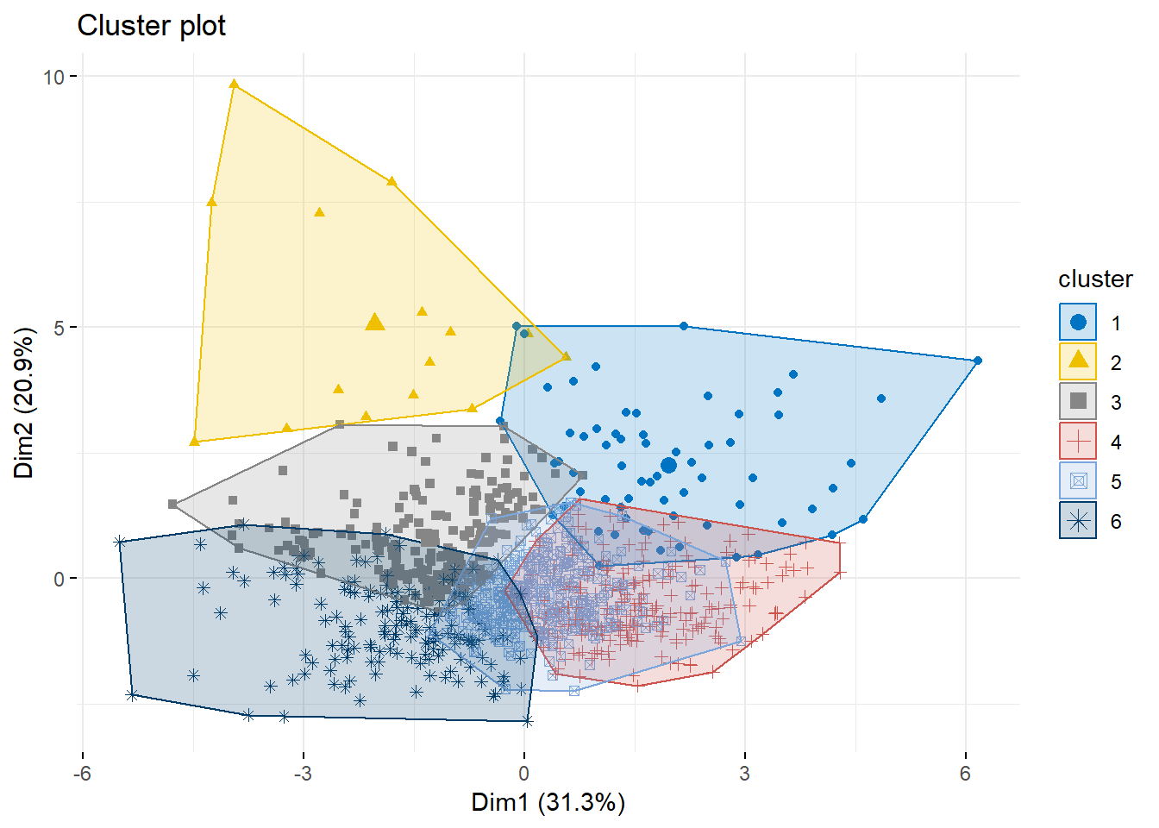
3nd Approach:
- 6 means clusters
- Important variables

Slide 15
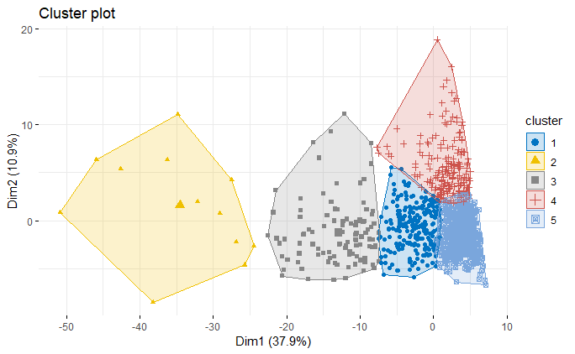
-5 mean clusters from 1st approach

Slide 16
Table 2: The Distribution of Number of Observations in Each Cluster
5 means clusters | Numbers of observation
1 | 232
2 | 12
3 | 102
4 | 183
5 | 530

Slide 17
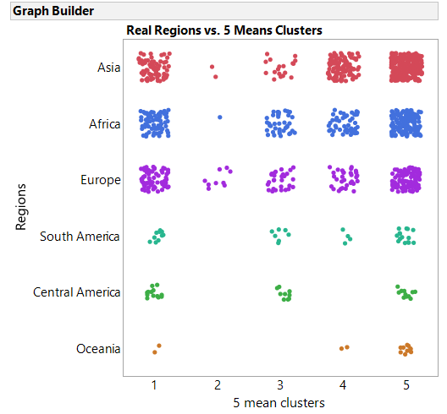
Cluster #2:
9 out of 12 are from Europe
2 belongs to Asia
1 belongs to Africa

Slide 18
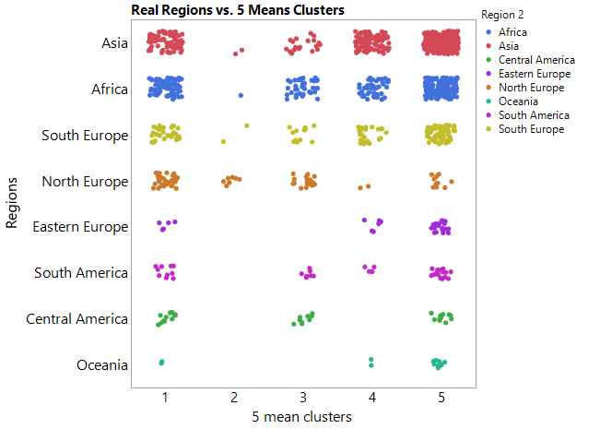
7 of 9 observation of Europe is from North
2 of them from South
0 from East

Slide 19
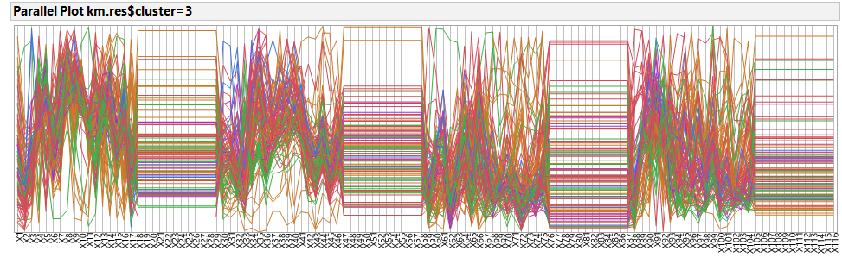
Overall:

Slide 20
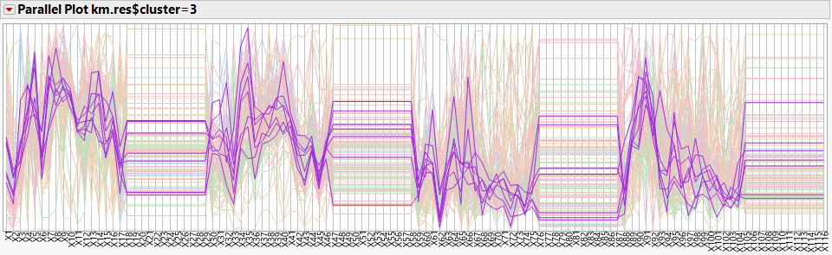
South America:
Important Variables: X2, X5, X6, X44, X45, X59, X62, X88

Slide 21
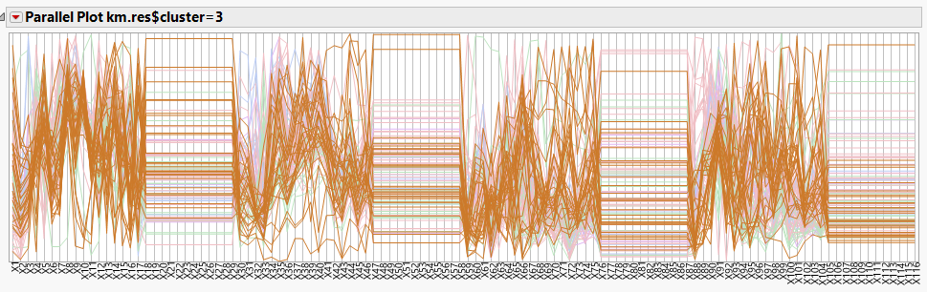
Europe:
Important Variables: X8, X9, X10, X91.

Slide 22
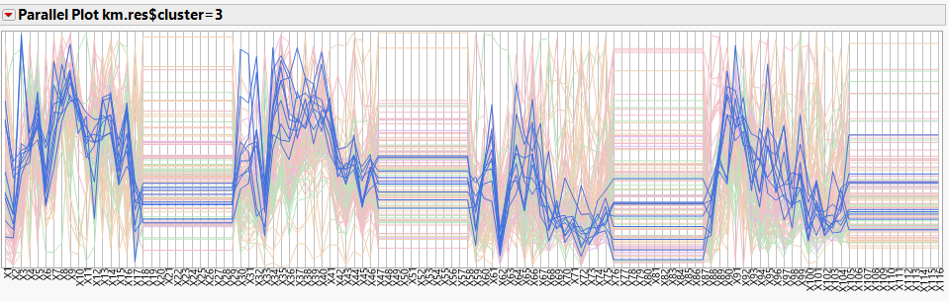
Central America:
Important Variables: X5, X6, X15, X16, X59, X62

Slide 23
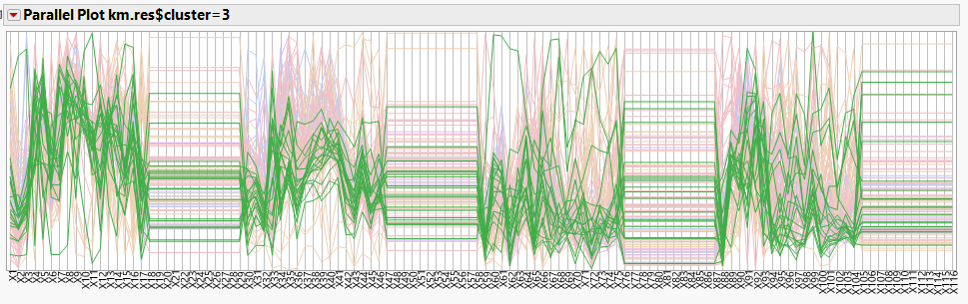
Asia:
Important Variables: X2, X6, X43, X59, X62, X88.

Slide 24
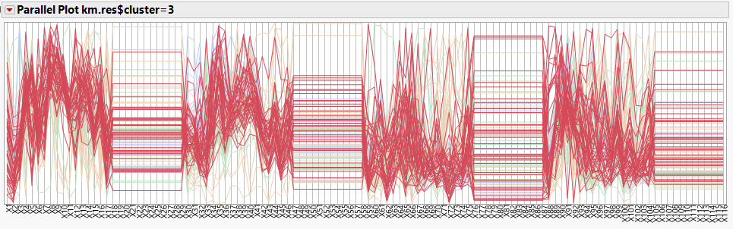
Africa:
Important Variables: X7, X8, X9, X43, X45.

Slide 25
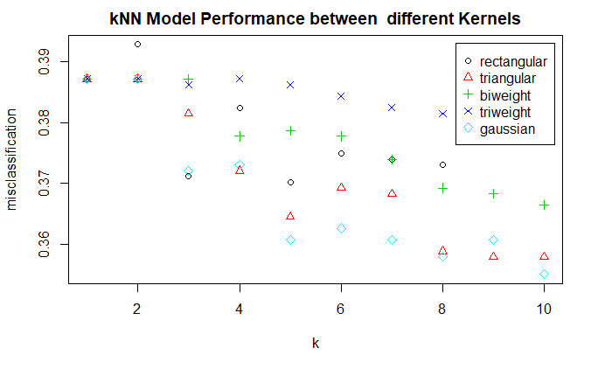

Slide 27
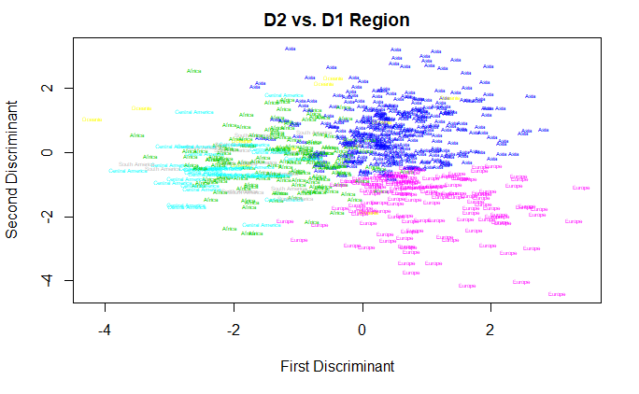
Europe
Asia
Africa
Central America
South America
Ocenia

Slide 28
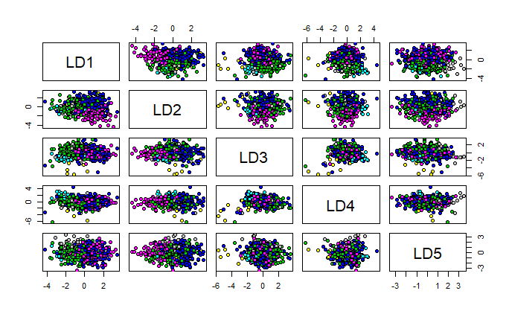
Europe
Asia
Africa
Central America
South America
Ocenia

Slide 29
Table3: The Misclassification Rates for Multiple Classification Comparison Models
Model | Misclassification rate from validation set
K nearest neighbor K=1, Rectangular | 0.3900
K nearest neighbor K=7, Biweight | 0.3750
K nearest neighbor K=9, Triweight | 0.3750
K nearest neighbor K=9, Triangular | 0.3670
K nearest neighbor K=1, Gaussian | 0.3900
KNN Monte Carlo CV, Gaussian | 0.3942
Naive Baves | 0.6440
Naive Baves, Monte Carlo CV | 0.6557
LDA | 0.4320
RDA with gamma = 0.004316288 and lambda = 0.865518083 | 0.3900

Slide 30
Issues Encountered & Lessons Learnt
We did not run the Quadratic Discriminant Analysis in R as we were having an error on “some groups are small to be used in the analysis”. This was a result of having some clusters with fewer observations than the total number of predictors. (n < p) problem.
We thought that since the music came from different regions, then it could be easily identified with their region of origin. But some music from different regions had similar attributes with music from other regions.

Slide 31
Conclusion
Four groups of variables that are highly correlated.
Do not have sufficient distinct qualities that can be grouped together according to the area of region.
Some variables which were important in grouping audio tracks from a particular region together if they were in the same cluster.
Most of the classification methods also did have problems with correctly classifying the audio track to a particular region.
Naive Bayes algorithm has the worst misclassification rate.
9-Nearest Neighbors with Triangular kernel is the model that performed best

Slide 32
Where does the data from?
https://archive.ics.uci.edu/ml/datasets/Geographical+Original+of+Music
https://uc-r.github.io/hc_clustering
https://www.datanovia.com/en/blog/types-of-clustering-methods-overview-and-quick-start-r-code/#hierarchical-clustering

Slide 33
Question?

